Slide 1
Semantic Image Classification
Jared Spang

Slide 2
Presentation Contents
Motivation
Overview of the model
Detailed view of the model
Semantic augmentation
Analysis
Conclusion

Slide 3
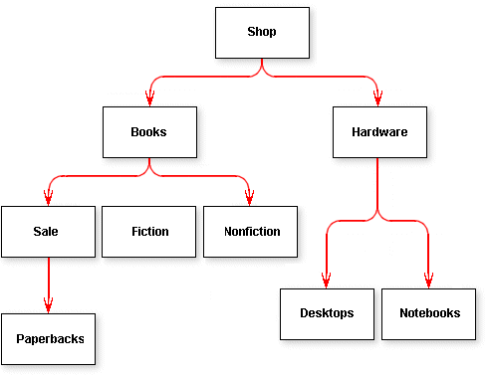
Motivation
Can we improve on image classification tasks through the use of semantics?
Image relationships, image hierarchies, etc.
ImageNet images form hierarchies [1]
Figure 1: Example of a hierarchy [2]

Slide 4
Related Work
“Imagenet classification with deep convolutional neural networks” [11]
“Improving image classification using semantic attributes” [12]
“The intelligent surfer: Probabilistic combination of link and content information in pagerank” [13]
“Semantic object recognition by merging decision tree with object ontology” [14]

Slide 5
Overview of the Model

Slide 6
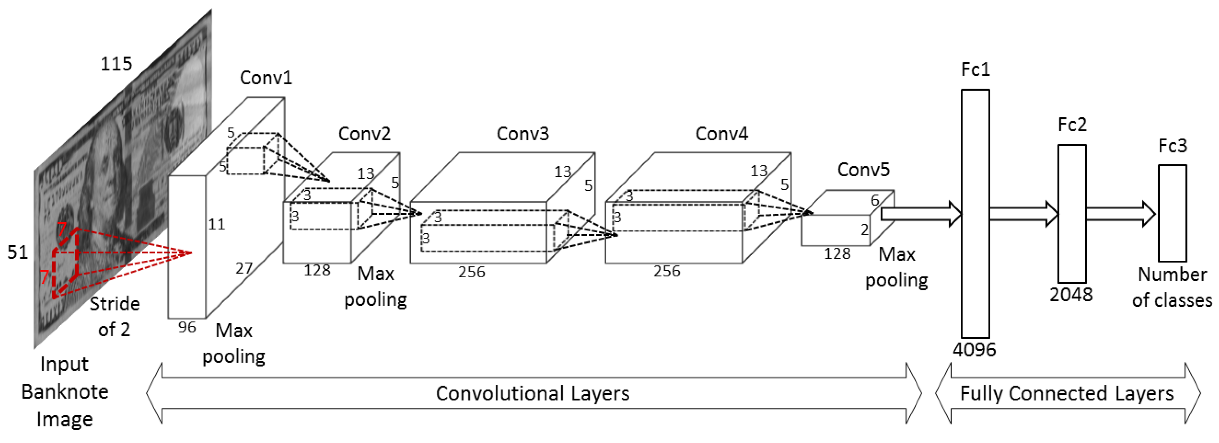
Figure 2: Example of a CNN for Banknote classification [3]
Semantic Augmentation
ImageNet Images
Convolutional Neural Network
Results

Slide 7
The Data
What is ImageNet? [1]
A very large (~14.2 million) image database used in object recognition research and competition
Data cleaning and preprocessing
Synset merging (via link for space), removing corrupt images, resizing, etc.
Hierarchy scraping to form Turtle file
ImageNet Semantic backing by WordNet nouns

Slide 8
Deeper View of the Model

Slide 9
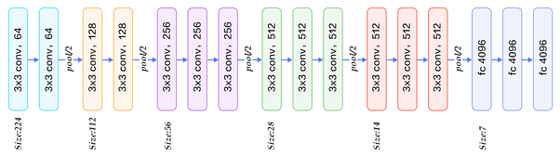
The Model Mk. 3 (final)
Utilized VGG16 framework using transfer learning for feature extraction then added two fully connected layers (256, 64) and the output (9)
ReLU
ReLU
Sigmoid
256
64
9
Loss Function: Binary Cross-Entropy

Slide 10
Semantic Augmentation

Slide 11
Subsection of ImageNet Knowledge Graph
Prickly Pear
Cactus
Cholla
Plant
Oak
Deciduous
Tree
Birch
Conifer
Pine

Slide 12
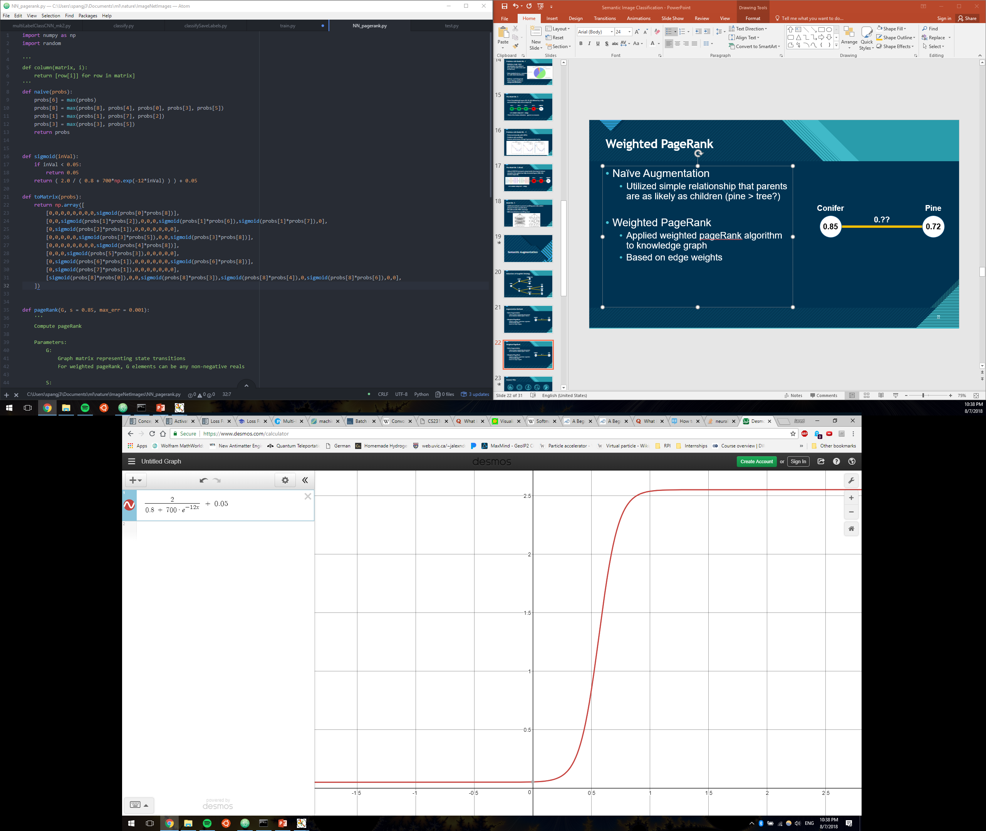

Augmentation Methods
Naïve Augmentation
Utilized simple relationship that parents are as likely as children (pine > tree?)
Weighted PageRank
Applied weighted pageRank algorithm to knowledge graph
Based on edge weights
Conifer
Pine
0.??
0.85
0.72

Slide 13
Analysis

Slide 14
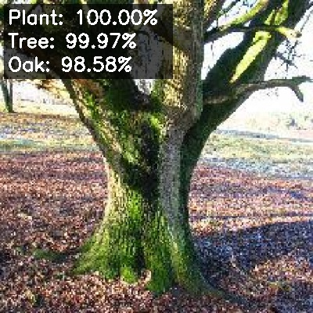
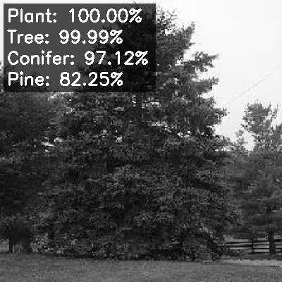
Convolutional Neural Network
Validation Accuracy: 90.5%
Train Accuracy: 96.2% (Overfitting)
Examples of Good Results:

Slide 15
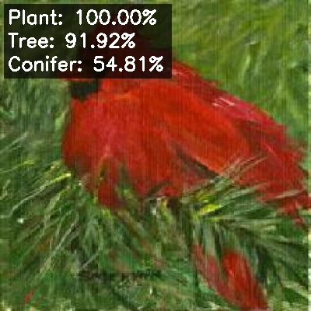
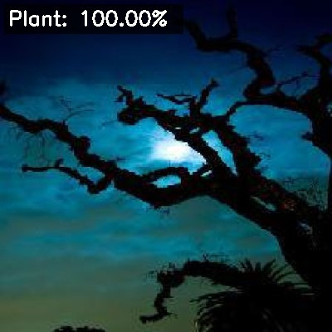
Harder Images
(Pine tree)
Close
(Oak tree)
Very Wrong

Slide 16
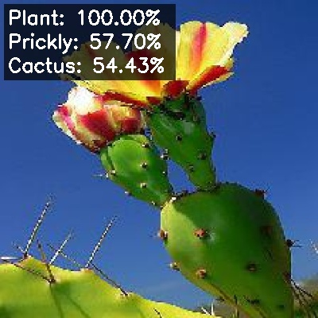
The Data Lies
Predicted to be Prickly Pear Cactus
This is indeed a Prickly Pear Cactus
However, was officially labeled Plant (from generic Plant category)
Causes loss and accuracy issues
Also, data imbalance

Slide 17
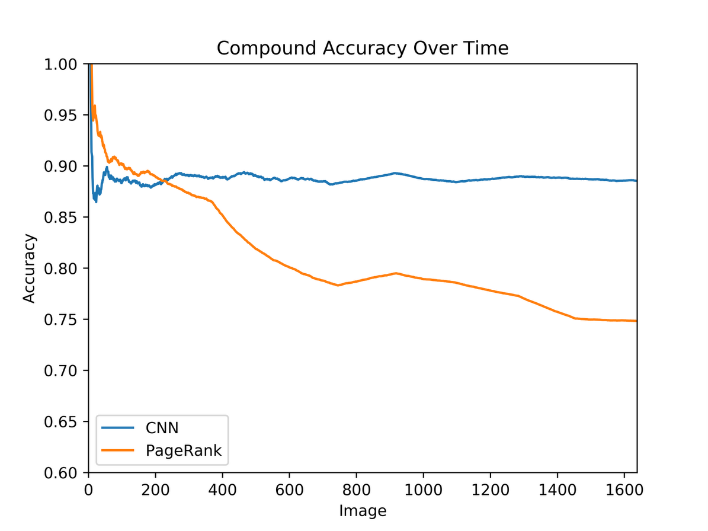
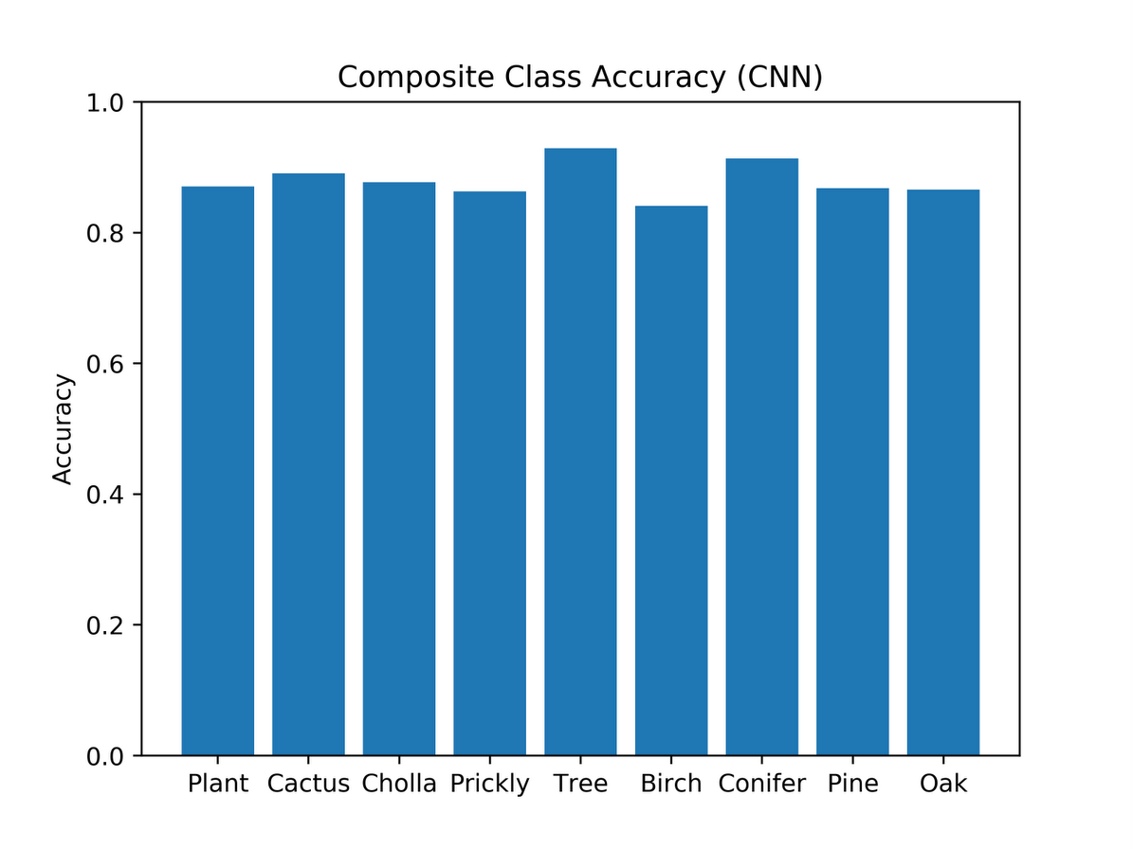
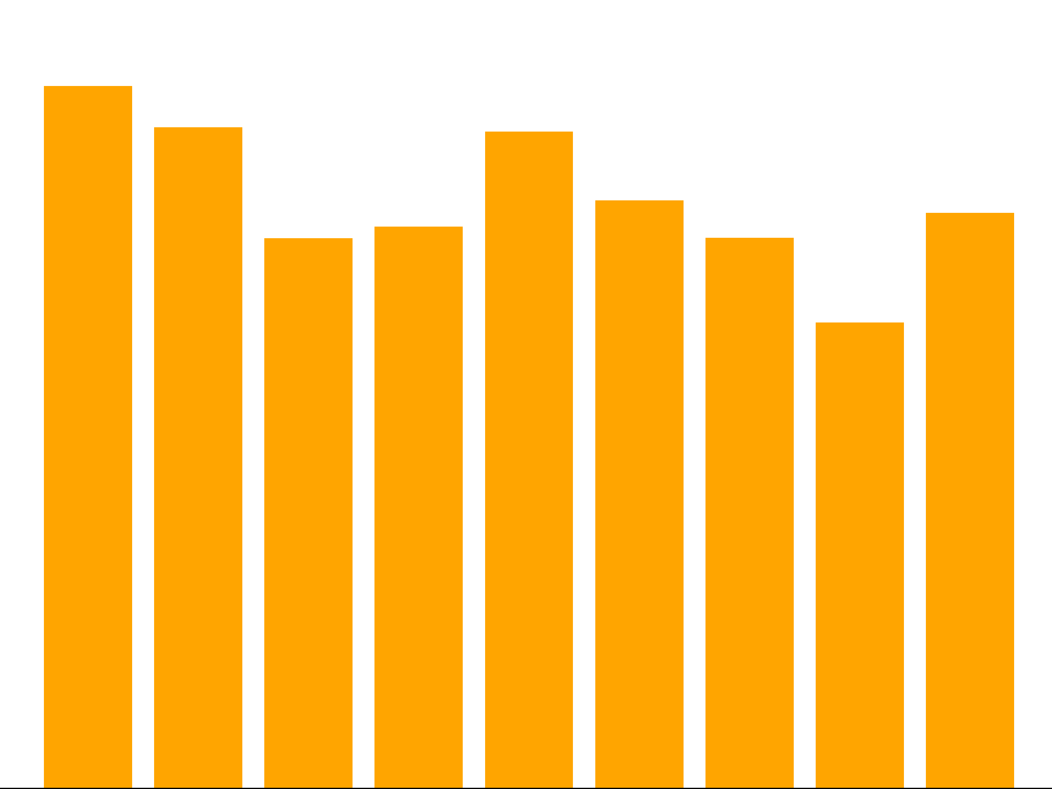
CNN vs Weighted PageRank
PageRank:
CNN:
Figure 12: Compound Accuracy
Figure 13: Semantic Composite Accuracy

Slide 18
CNN vs Naïve Semantic Augmentation
Naïve method: if a child node is labeled so must the parents
This had no effect on the results whatsoever
Figure 14: CNN Composite Accuracy

Slide 19
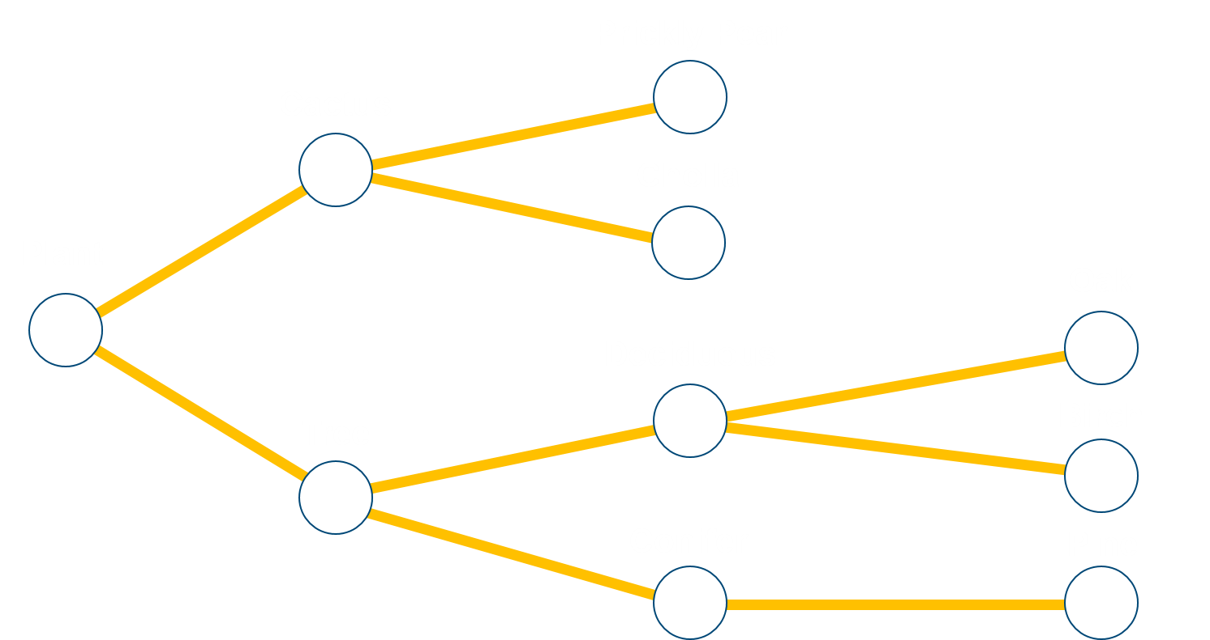
Future Work
Better results from more complex ontology
Tweak pageRank parameters
Relies too much on graph position
Use different node ranking algorithm
Leveraging semantics to improve results

Slide 20
Questions?

Slide 21
References
Olga Russakovsky*, Jia Deng*, Hao Su, Jonathan Krause, Sanjeev Satheesh, Sean Ma, Zhiheng Huang, Andrej Karpathy, Aditya Khosla, Michael Bernstein, Alexander C. Berg and Li Fei-Fei. (* = equal contribution) ImageNet Large Scale Visual Recognition Challenge. IJCV, 2015.
Naidamast, Steve. “Poor Man’s Hierarchy Data Tree.” Codeproject, Sept. 2017, www.codeproject.com/Articles/1205166/WebControls/WebControls/.
Pham, Tuyen Danh, et al. “Multi-National Banknote Classification Based on Visible-Light Line Sensor and Convolutional Neural Network.” Sensors, vol. 17, no. 7, 2017, p. 1595., doi:10.3390/s17071595
“Neural Network”. (n.d.). In Wikimedia Commons. Retrieved August 7, 2018, from commons.wikimedia.org/wiki/File:Neural_Network.gif
“Typical CNN”. (n.d.). In Wikimedia Commons. Retrieved August 7, 2018, from commons.wikimedia.org/wiki/File:Typical_cnn.png
“Max Pooling”. (n.d.). In Wikimedia Commons. Retrieved August 7, 2018, from commons.wikimedia.org/wiki/File:Max_pooling.png
Kottwitz, Stefan. “Latex Cookbook.” Latex Cookbook, 2015, latex-cookbook.net/cookbook/examples/pie-chart/.
Overfitting. (n.d.). In Wikimedia Commons. Retrieved August 8, 2018, from commons.wikimedia.org/wiki/File:Overfitting.svg
Srivastava, Nitish, et al. "Dropout: a simple way to prevent neural networks from overfitting." The Journal of Machine Learning Research 15.1 (2014): 1929-1958.

Slide 22
References
Sorower, Mohammad S. "A literature survey on algorithms for multi-label learning." Oregon State University, Corvallis 18 (2010).
Krizhevsky, Alex, Ilya Sutskever, and Geoffrey E. Hinton. "Imagenet classification with deep convolutional neural networks." Advances in neural information processing systems. 2012.
Su, Yu, and Frédéric Jurie. "Improving image classification using semantic attributes." International journal of computer vision 100.1 (2012): 59-77.
Richardson, Matthew, and Pedro Domingos. "The intelligent surfer: Probabilistic combination of link and content information in pagerank." Advances in neural information processing systems. 2002.
Damak, Wafa, Issam Rebai, and Imene Khanfir Kallel. "Semantic object recognition by merging decision tree with object ontology." Advanced Technologies for Signal and Image Processing (ATSIP), 2014 1st International Conference on. IEEE, 2014.

